Slide 1
Stage 5: Evaluating a food product

Slide 2
Warm up!
Can you remember the words to the heads, shoulders, knees and toes song?

Slide 3
Our senses
Our senses help us to make sense of the world around us. They give us information and help to keep us safe.
We use our eyes for our sense of sight.
We use our ears for our sense of hearing.
We use our skin for our sense of touch.
We use our nose for our sense of smell.
We use our tongue for our sense of taste.

Slide 4
Exploring sight

Slide 5
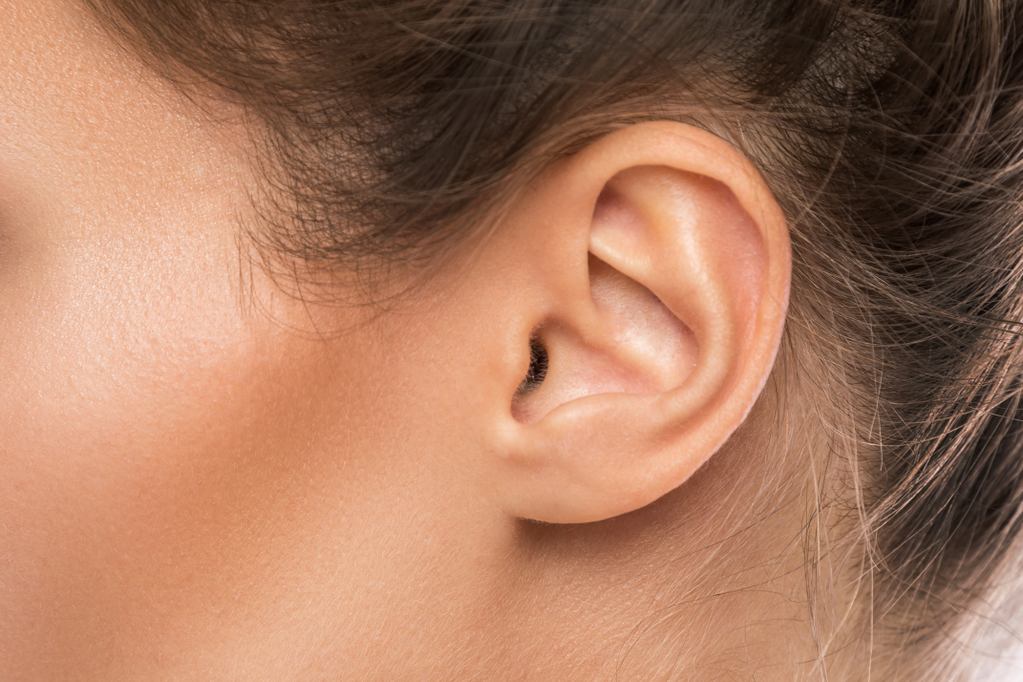
Exploring hearing

Slide 6
Exploring touch

Slide 7
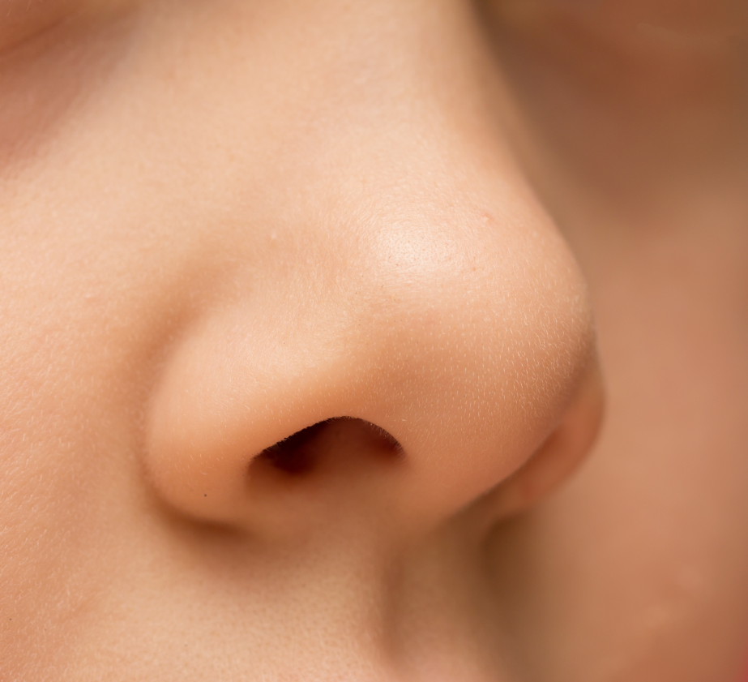
Exploring smell

Slide 8
Exploring taste

Slide 9
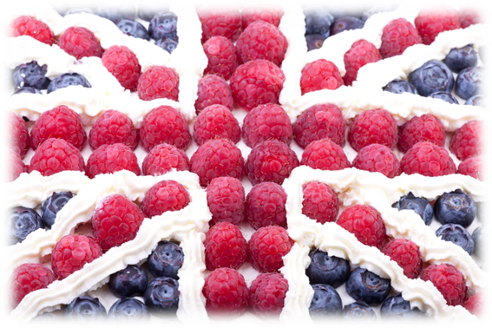
Yoghurt evaluation
How does your product look?
How does it smell?
How does it taste and feel?
Count how many pieces of each fruit you used. Was it the same as your plan or were there more, the same or fewer?

